Slide 1
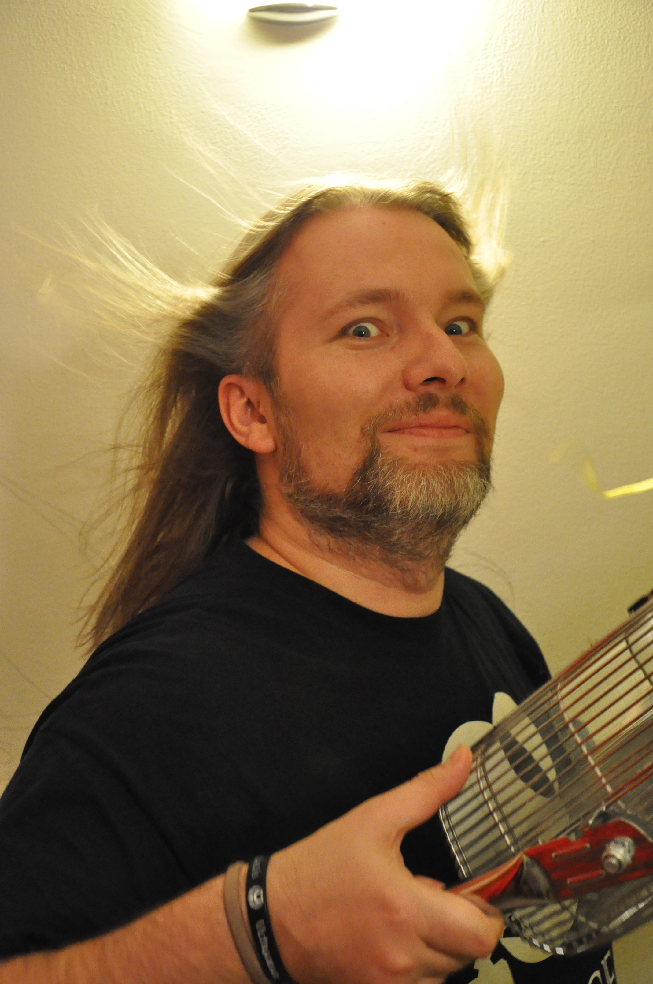
Shaders and Magic
GodotFest 2026
Leszek Nowak
Teach game dev at Jagiellonian University
Made over 30 random games
co-creator of 0! Crunch Entertainment

Slide 2

Lumencraft

Slide 3
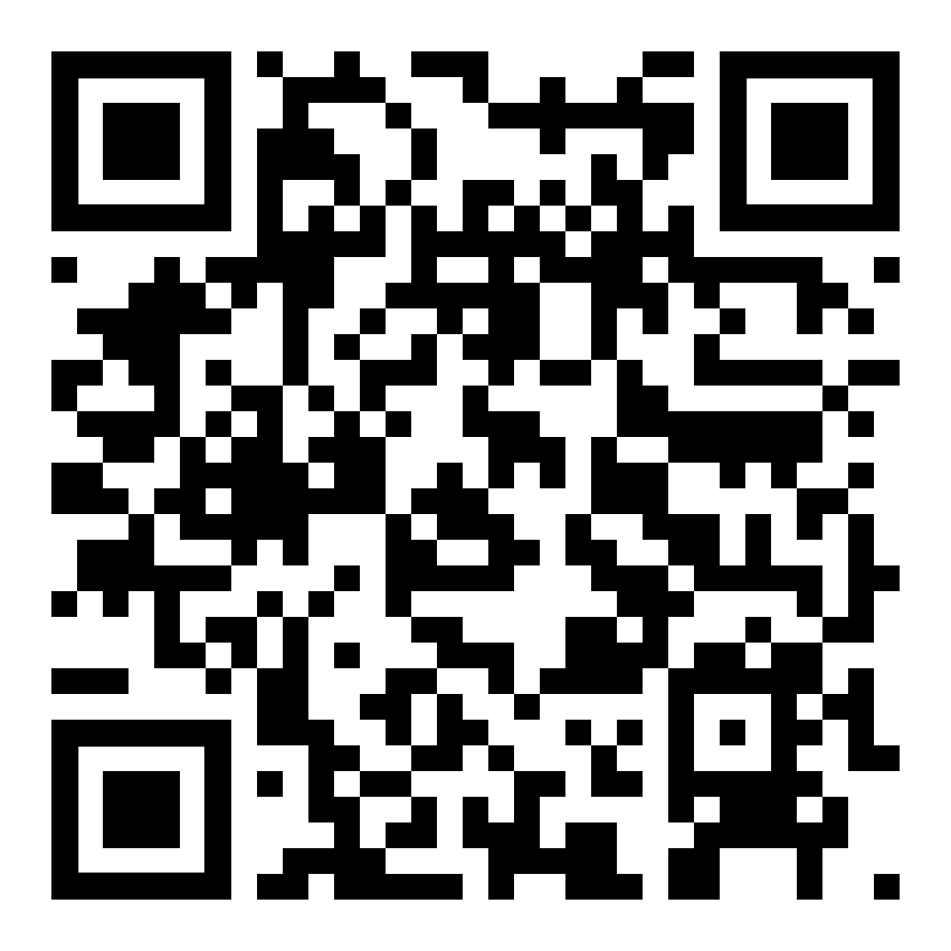
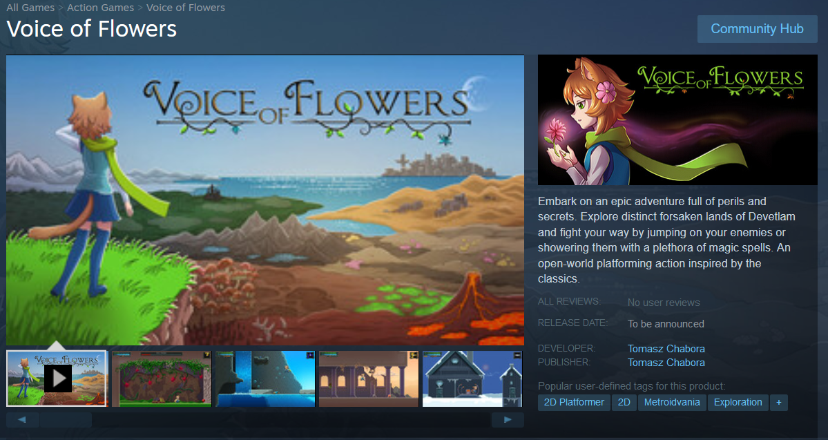

Slide 4
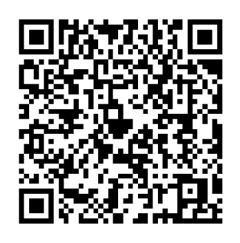
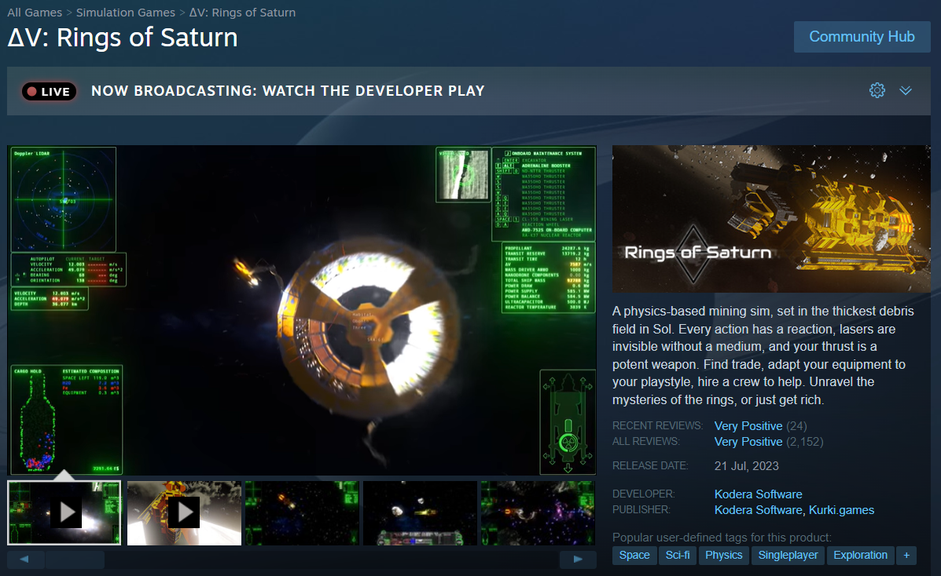

Slide 5
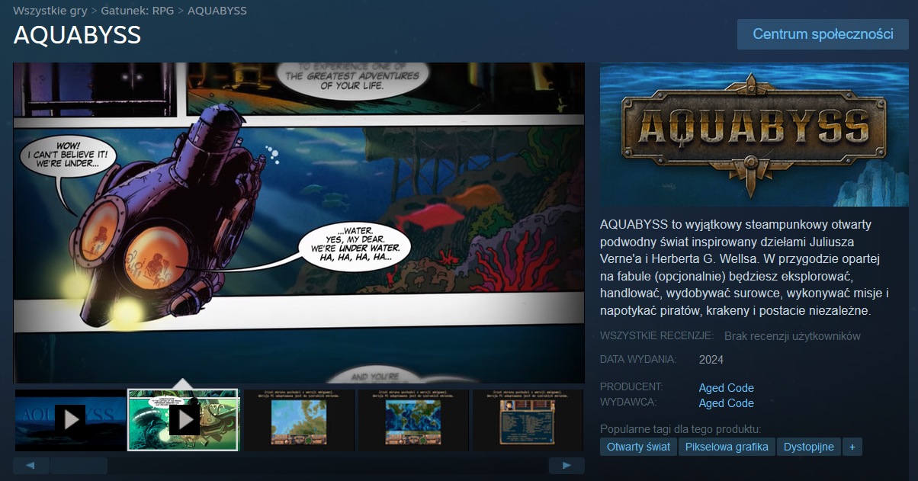

Slide 6
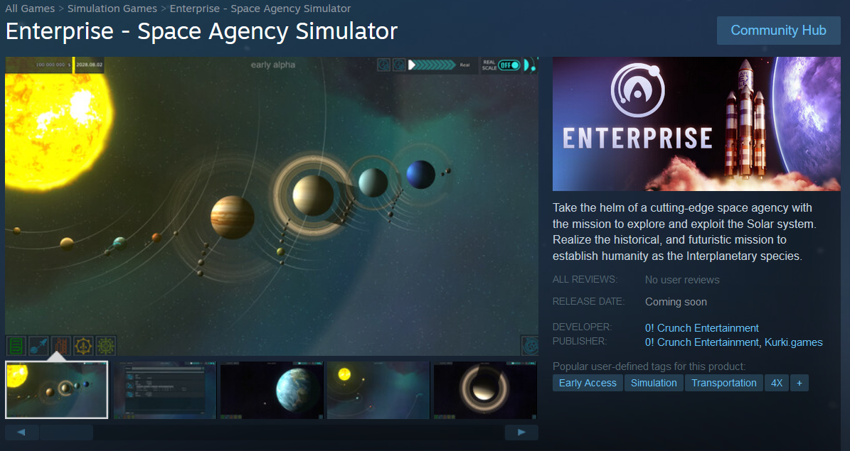

Slide 7
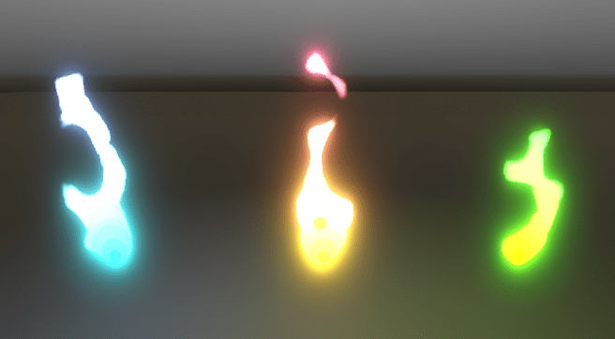
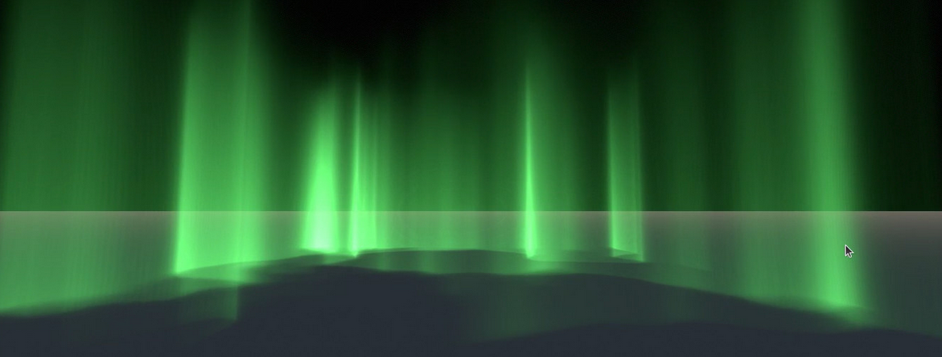
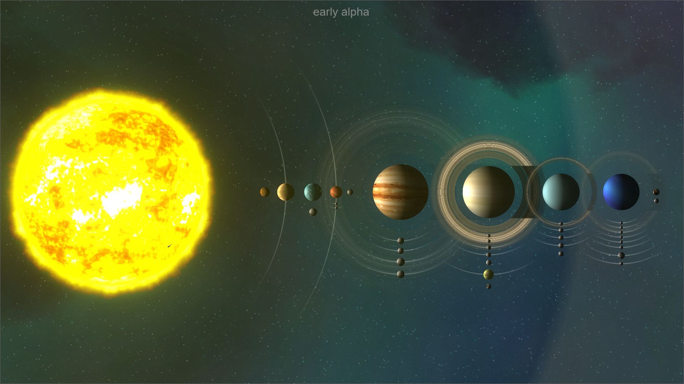
Where to start?
https://www.gdquest.com/library/first_shader_godot4_portal/
https://github.com/gdquest-demos/godot-shaders
https://github.com/miskatonicstudio/godot-experiments
https://godotshaders.com/shader/
https://thebookofshaders.com
https://github.com/JohnMeadow1/Enterprise-space-shaders

Slide 8
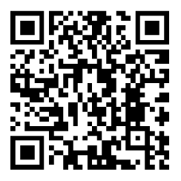
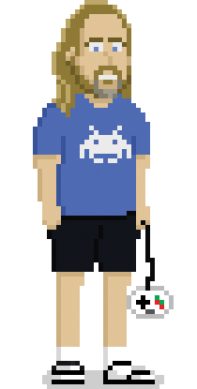

This presentation
and previous:
www.johnmeadow.itch.io
www.github.com/JohnMeadow1
www.reddit.com/user/JohnMeadow2
www.twitter.com/JohnMeadow3
www.globalgamejam.org/users/john-meadow
https://store.steampowered.com/app/2579820/Enterprise__Space_Agency_Simulator/

